Slide 1

CSE 302 Project Idea Presentation

Slide 2
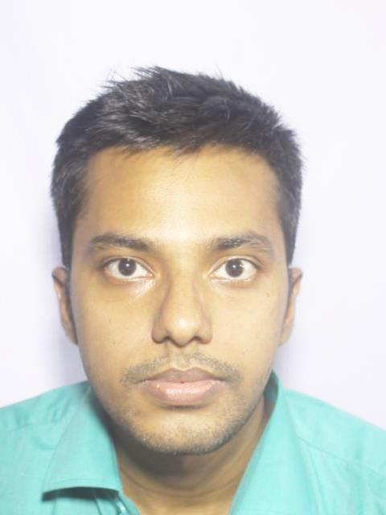
Group Members
Samirah Sohaili
ID: 201914041
Student of MIST
Abdullah Al Masum ID: 201914044
Student of MIST
Fahim Sharyr
ID: 201914019
Student of MIST

Slide 3
Blood Bank Management System
1

Slide 4
Project Objective
To automate the whole operations of blood bank making user friendly
To ensure that every patient has access to adequate quantity of safe blood in a centralized manner
To make this web app such user friendly that new doner will be encouraged to donate

Slide 5
Language & Tools
Application:
Web-app
Front-end:
Python Django Framework
Back-end: Python
DataBase: Oracle

Slide 6
Features
Doner’s profile
Receiver’s profile
Nearest hospital / Doner
Groupwise blood columns (eg: A+ve, AB+ve etc)
Stock of blood available at present
Urgency notifier
Area-wise Hospital's ambulance contact number
Report after receiving blood

Slide 7
Pharmacy Management System
2

Slide 8
Project Objective
To automate the billing and storing of medicines in a systematic manner
To be able to generate report of medicines within a specified period of time.
To minimize time and resources so that finding of an medicine would be easy and fast
To ensure that the system is user friendly.

Slide 9
Language & Tools
Application:
Web-app
Front-end:
Python Django Framework
Back-end: Python
DataBase: Oracle

Slide 10
Features
Patient details profile
Category-wise medicine columns with price per unit
Medicines needed at present
Medicines needed to be stored
Medicine suppliers’ list
Paying system
Downloadable receipt

Slide 11
Restaurant Management System
3

Slide 12
Project Objective
To help restaurant administrator manage the restaurant business and help customer for online ordering and reserve table by our booking system
To provide fast, efficient and reliable system by the way of managing the records of all their transaction by our payment option
To evaluate the acceptability of proposed system by our review option
To ensure that the system is user friendly.

Slide 13
Language & Tools
Application:
Web-app
Front-end:
Python Django Framework
Back-end: Python
DataBase: Oracle

Slide 14
Features
Owner’s detailed information profile
Customer’s information profile
Menu wise price list with illustration of food
Price wise menu selection option
Ordering system
Payment system (Credit card, Mobile banking, cash etc)
Customer review option

Slide 15
Travel Management System
4

Slide 16
Project Objective
To make travelling easy and fun.
To give a proper idea of that unknown site. Give access to the user to compare among resorts,transportation,restaurent,pros and cons so they can be benifited economically
Bloggin section gives a user access to post their experiences and see others experience to take right decision while travelling that particular place

Slide 17
Project Objective
User can book hotel ,resort and transportation via the web-app
can make their transaction online
They can rate the tourist spot, resort and the restaurant . So others can get a proper idea
Booking a whole trip never been easier before

Slide 18
Language & Tools
Application:
Web-app
Front-end:
Python Django Framework
Back-end: Python
DataBase: Oracle

Slide 19
Features
Review System
User Credential
Place/Resort information
Blog with pic
Overall Rating
List of Resorts
Booking System
Distance mapping with Google api from our database
Price comparison with other resorts

Slide 20
Thanks!

